Slide 1
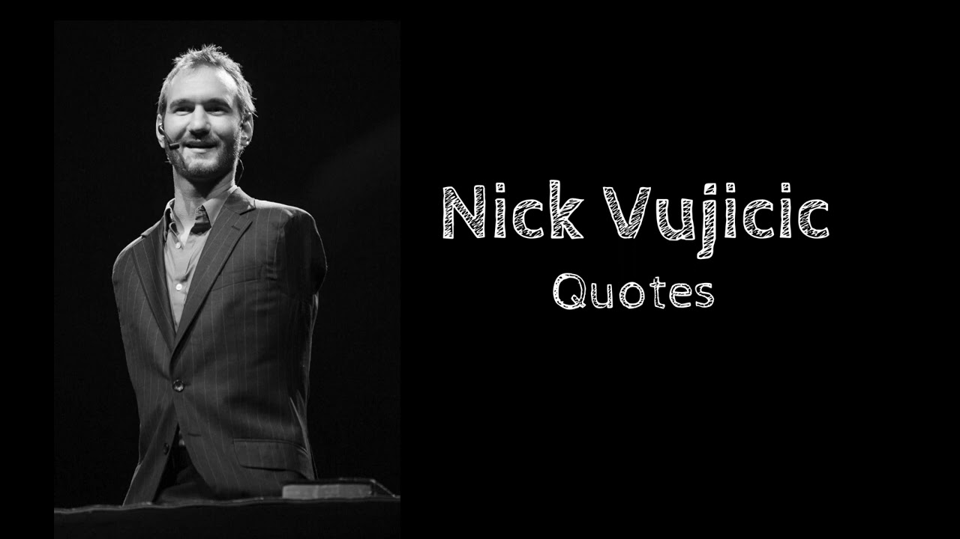
D
NICK
VUJICIC
-A LIFE WITHOUT LIMITS-

Slide 2
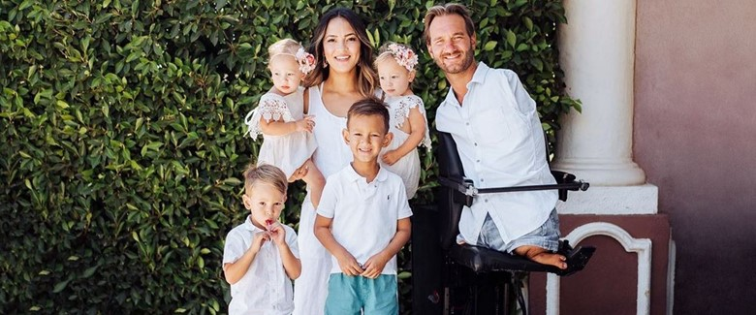
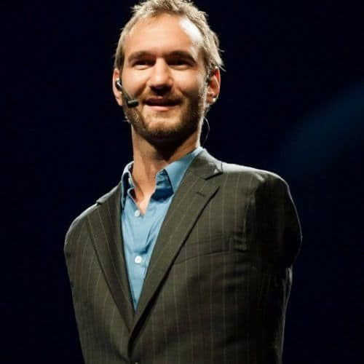
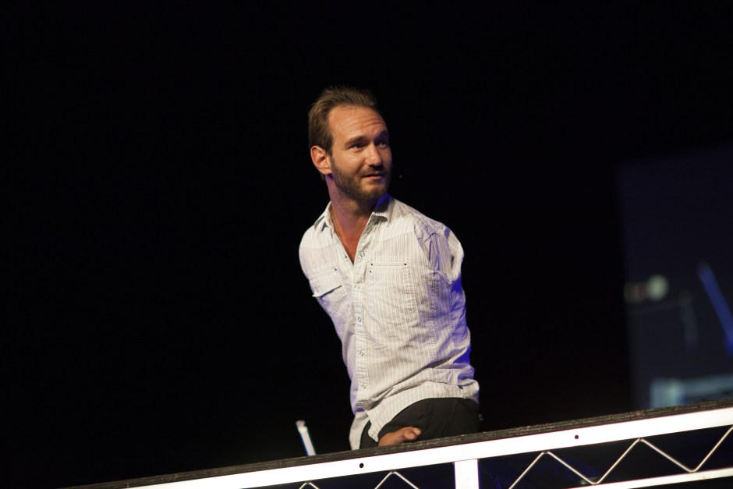
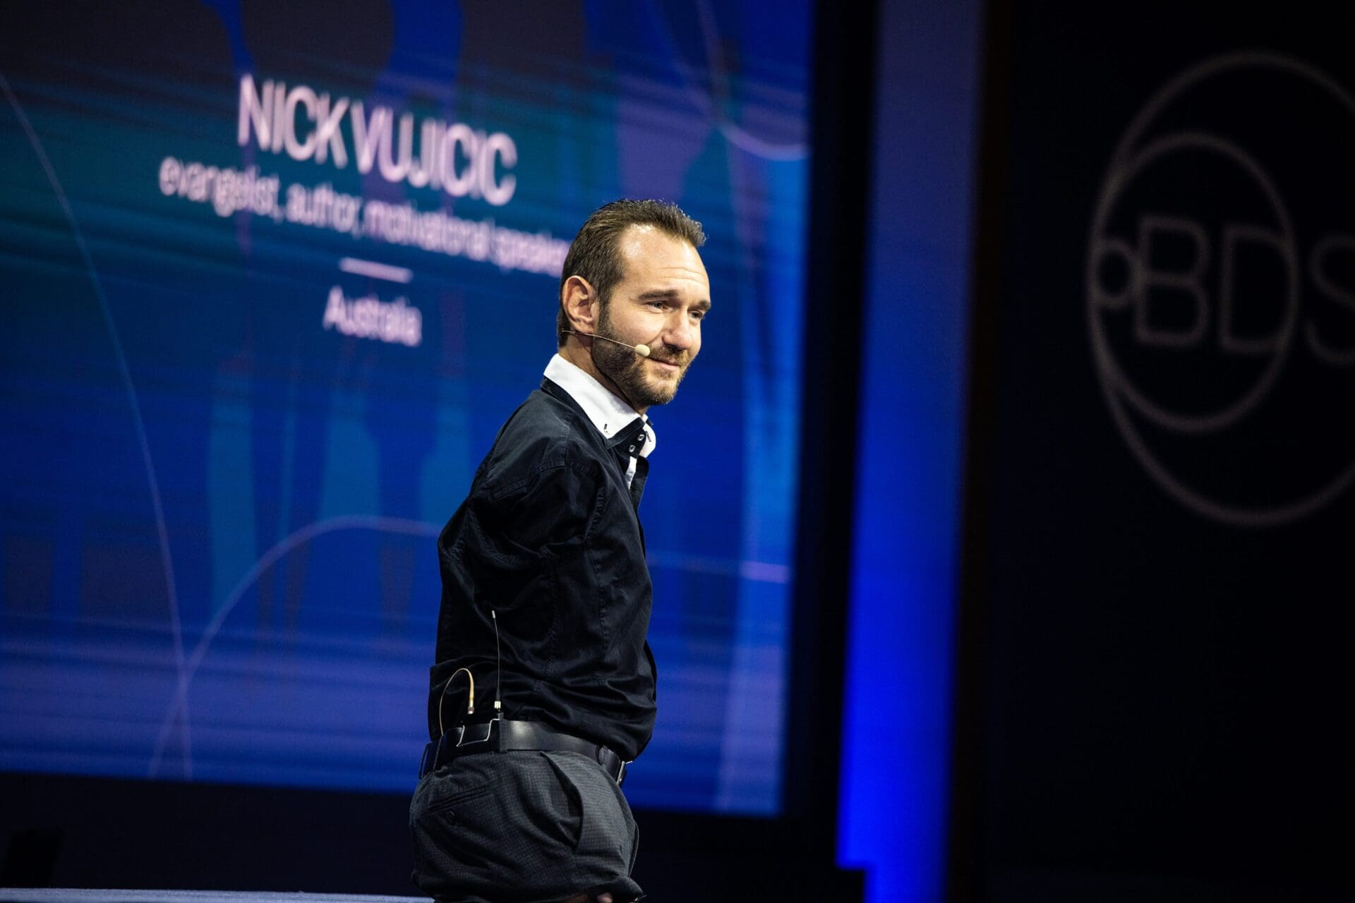

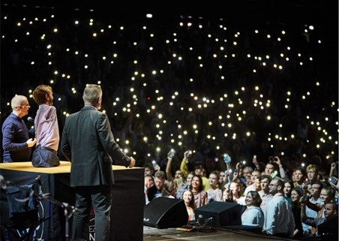
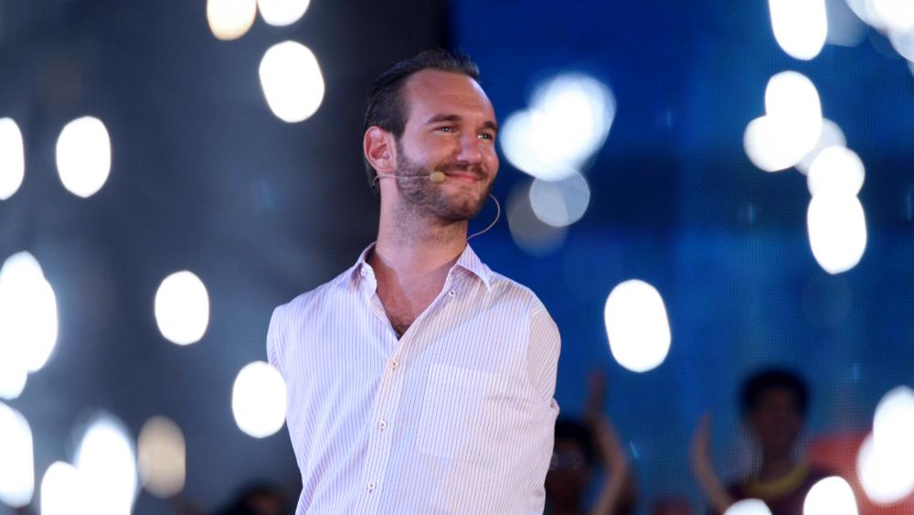
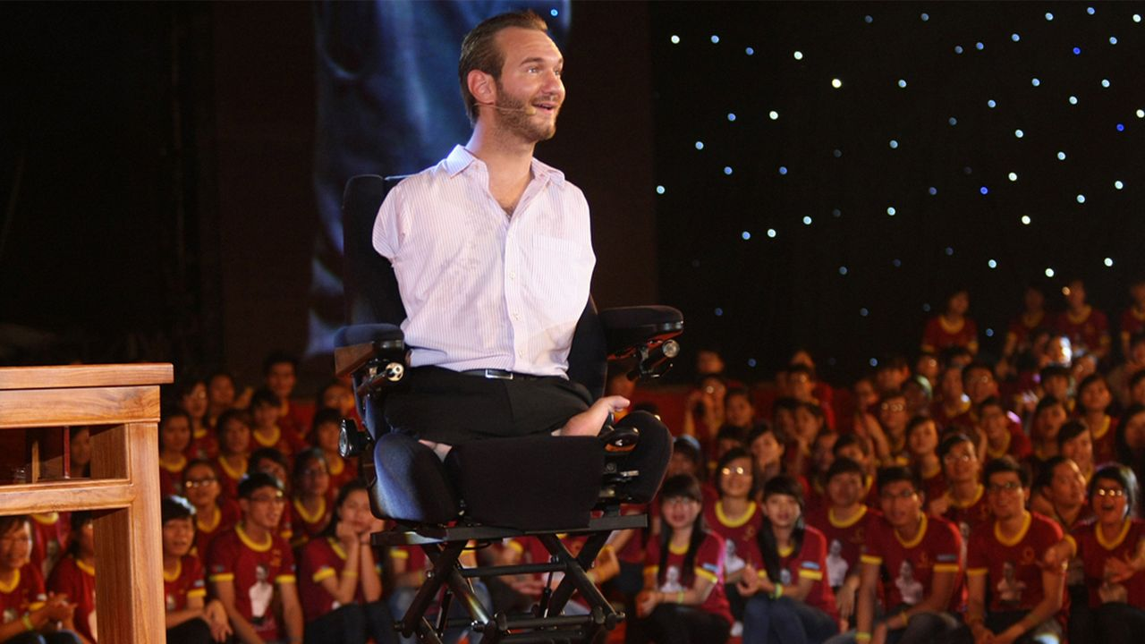
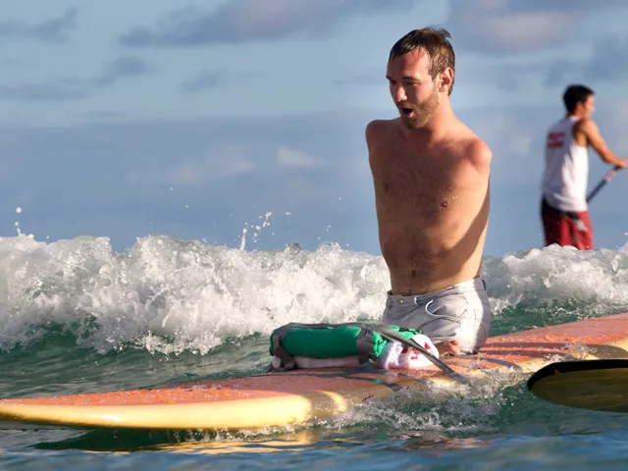
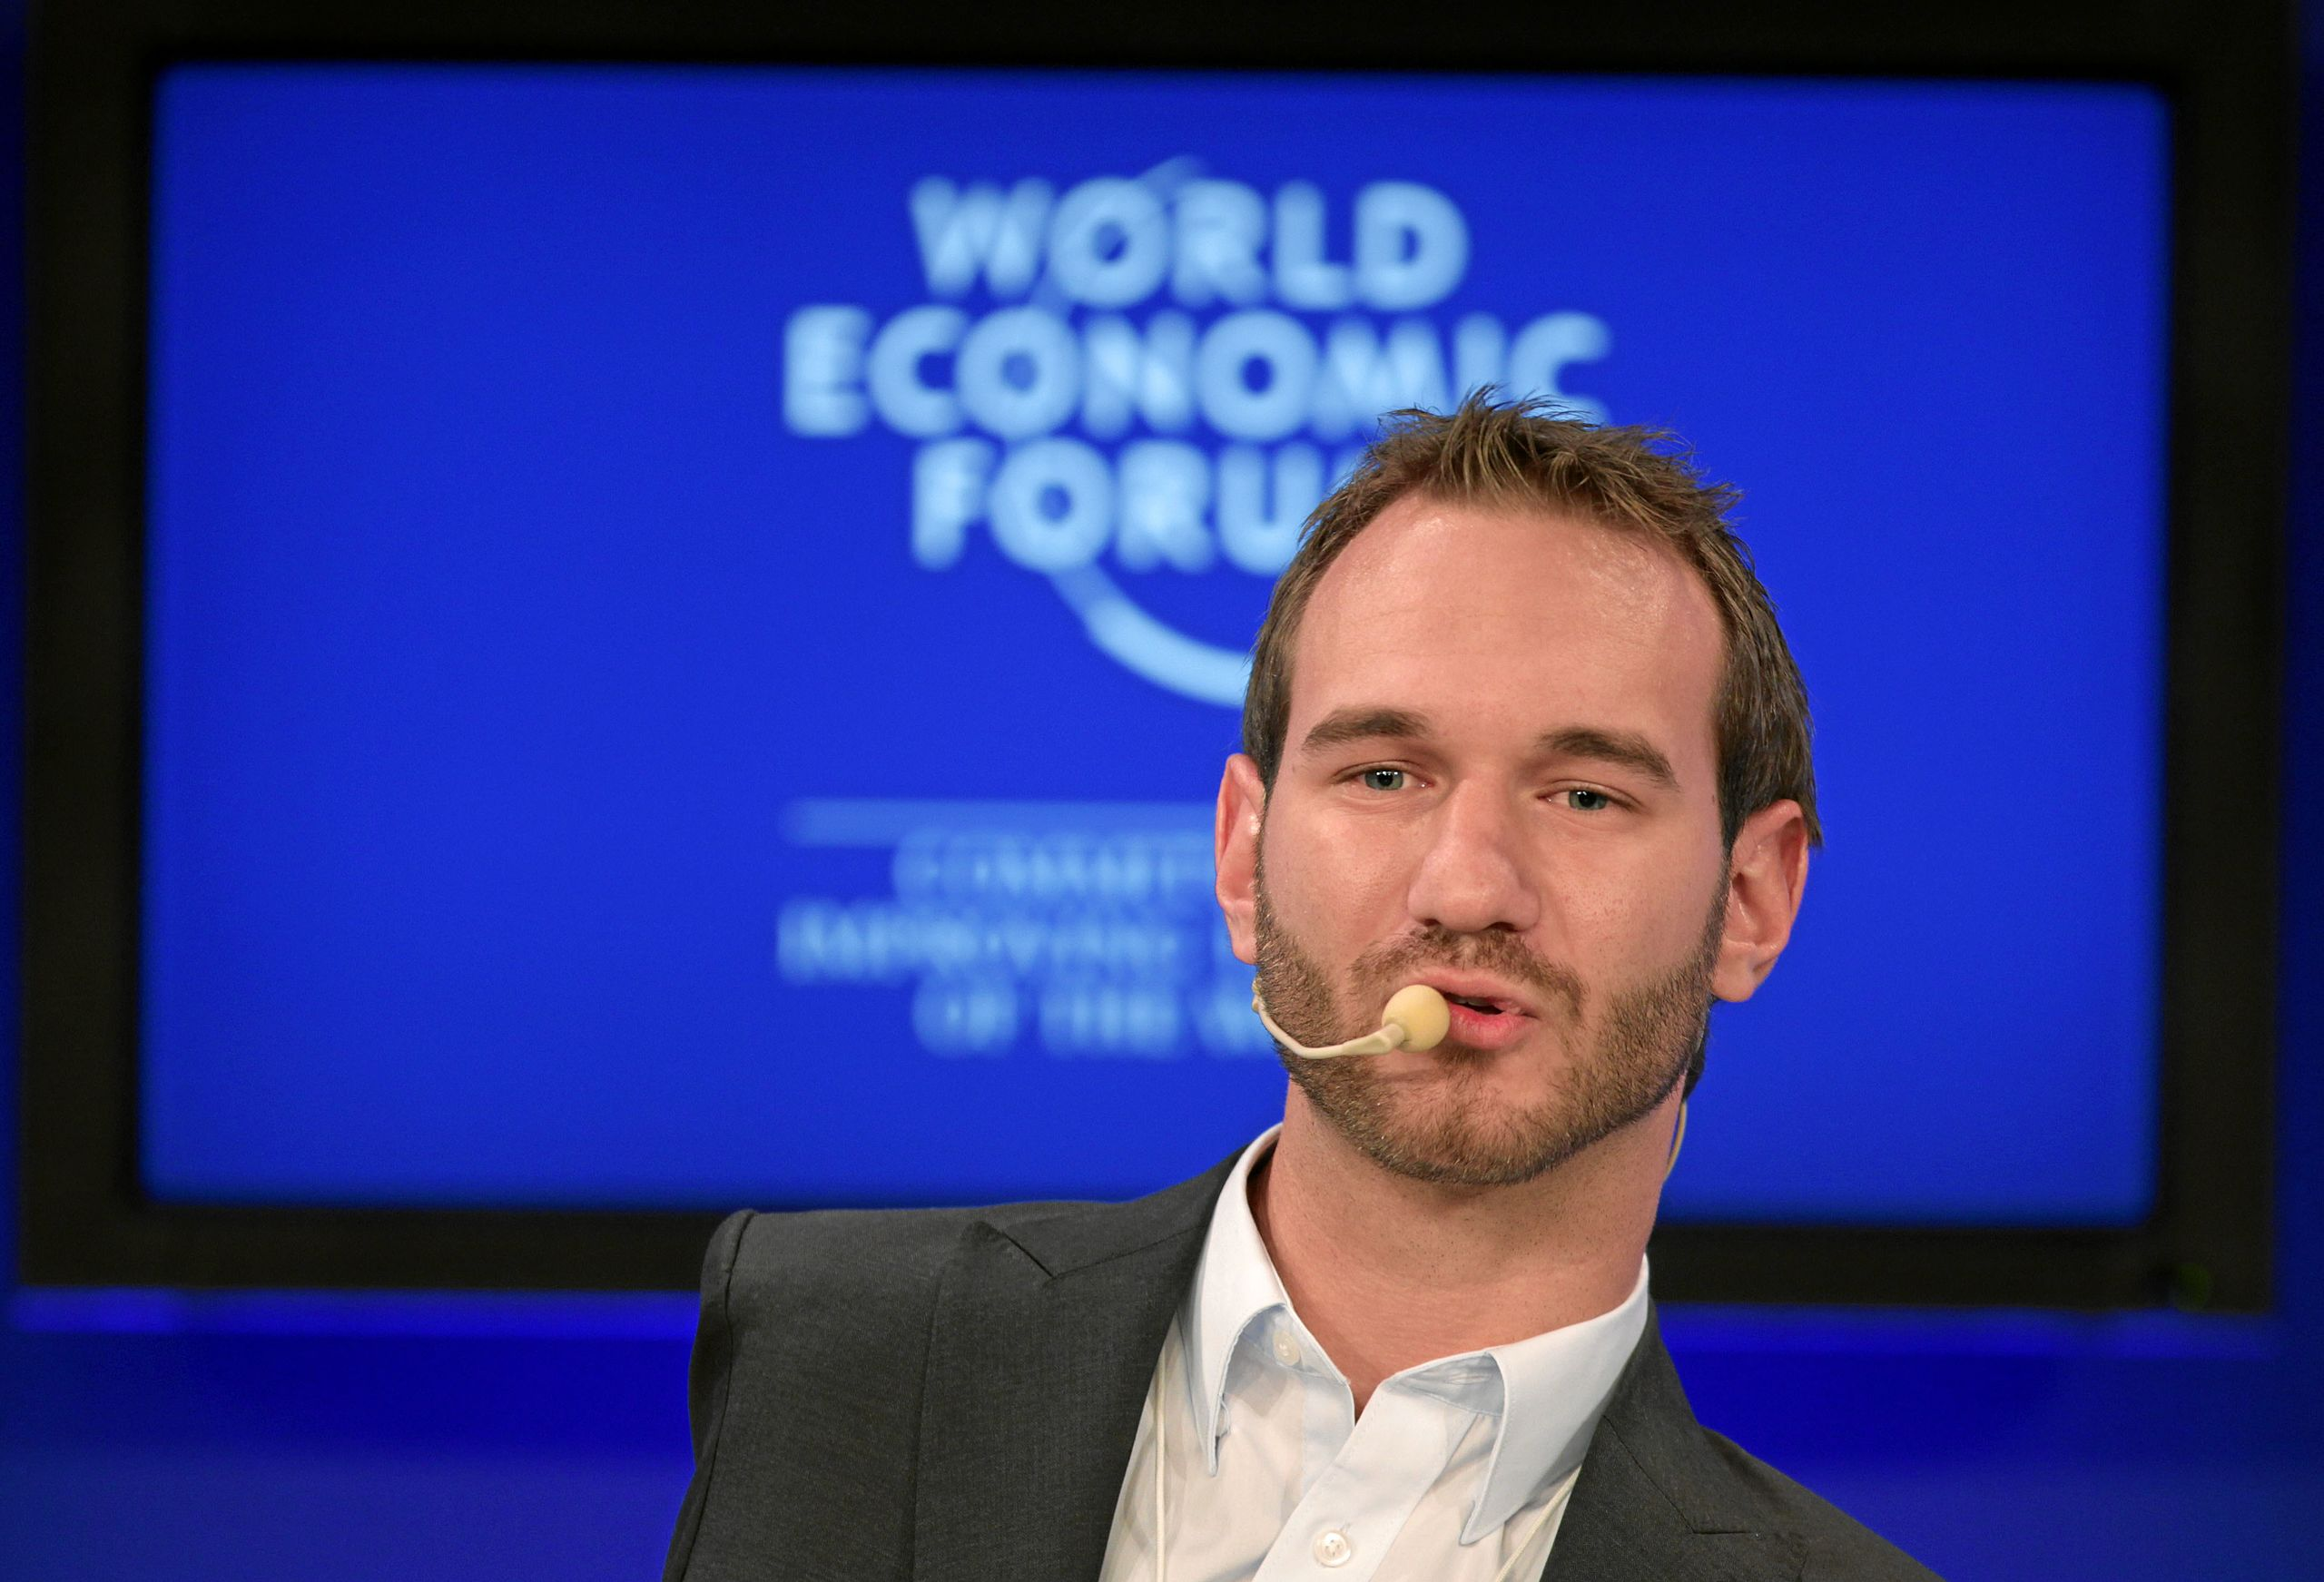
EARLY LIFE &
BACKGROUND
An Australian motivational speaker, author and evangelist
Born on December 4 ,1982 ,in Melbourne, Australia
Born without arms and legs, a rare condition known as tetra-amelia syndrome.
With the support of his family and his strong Christian faith
Graduated from Griffith University with a Bachelor of Commerce degree.
Gained international attention through his motivational speaking engagements

Slide 3


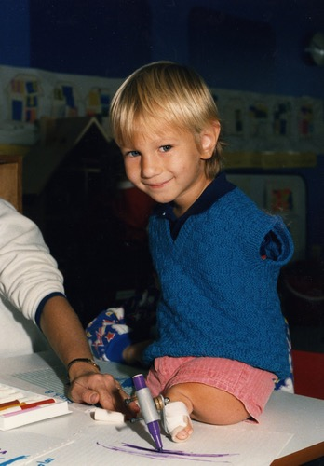
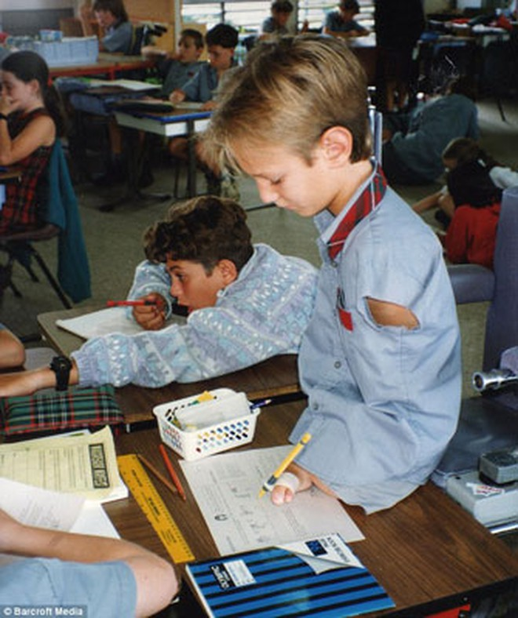
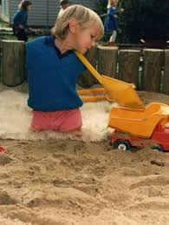
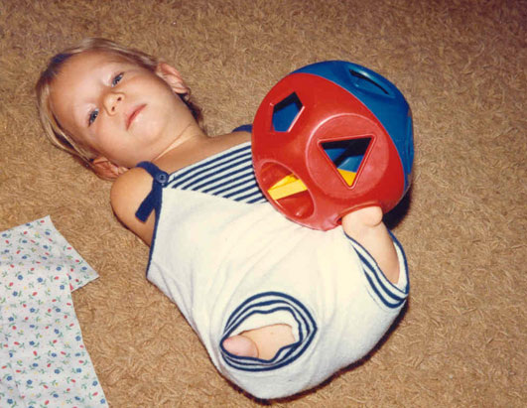
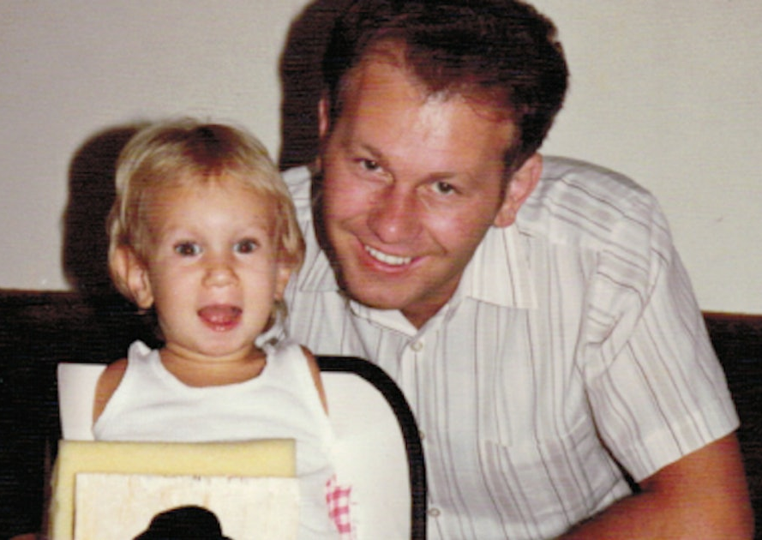
PHYSICAL LIMITATION
BULLYING & DISCRIMINATION
EMOTIONAL
STRUGGLES
EDUCATION & INDEPENDENCE
LIFE
CHALLENGES
Overcoming considerable daily challenges
From his peers due to his physical differences
Often felt isolated and struggled with self-esteem
Faced moments of despair and questioned his self-worth.
Went through periods of depression and loneliness
Learned to adapt and become independent
Developing innovative ways to accomplish tasks without limbs.
Graduated from Griffith University with a degree in Commerce.
Eating
Dressing
Writing

Slide 4
PHYSICAL LIMITATION
BULLYING & DISCRIMINATION
EMOTIONAL
STRUGGLES
EDUCATION & INDEPENDENCE
LIFE
CHALLENGES
Overcoming considerable daily challenges
From his peers due to his physical differences
Often felt isolated and struggled with self-esteem
Faced moments of despair and questioned his self-worth.
Went through periods of depression and loneliness
Learned to adapt and become independent
Developing innovative ways to accomplish tasks without limbs.
Graduated from Griffith University with a degree in Commerce.
Eating
Dressing
Writing

Slide 5
PHYSICAL LIMITATION
BULLYING & DISCRIMINATION
EMOTIONAL
STRUGGLES
EDUCATION & INDEPENDENCE
LIFE
CHALLENGES
Overcoming considerable daily challenges
From his peers due to his physical differences
Often felt isolated and struggled with self-esteem
Faced moments of despair and questioned his self-worth.
Went through periods of depression and loneliness
Learned to adapt and become independent
Developing innovative ways to accomplish tasks without limbs.
Graduated from Griffith University with a degree in Commerce.
Eating
Dressing
Writing

Slide 6
PHYSICAL LIMITATION
BULLYING & DISCRIMINATION
EMOTIONAL
STRUGGLES
EDUCATION & INDEPENDENCE
LIFE
CHALLENGES
Overcoming considerable daily challenges
From his peers due to his physical differences
Often felt isolated and struggled with self-esteem
Faced moments of despair and questioned his self-worth.
Went through periods of depression and loneliness
Learned to adapt and become independent
Developing innovative ways to accomplish tasks without limbs.
Graduated from Griffith University with a degree in Commerce.
Eating
Dressing
Writing

Slide 7
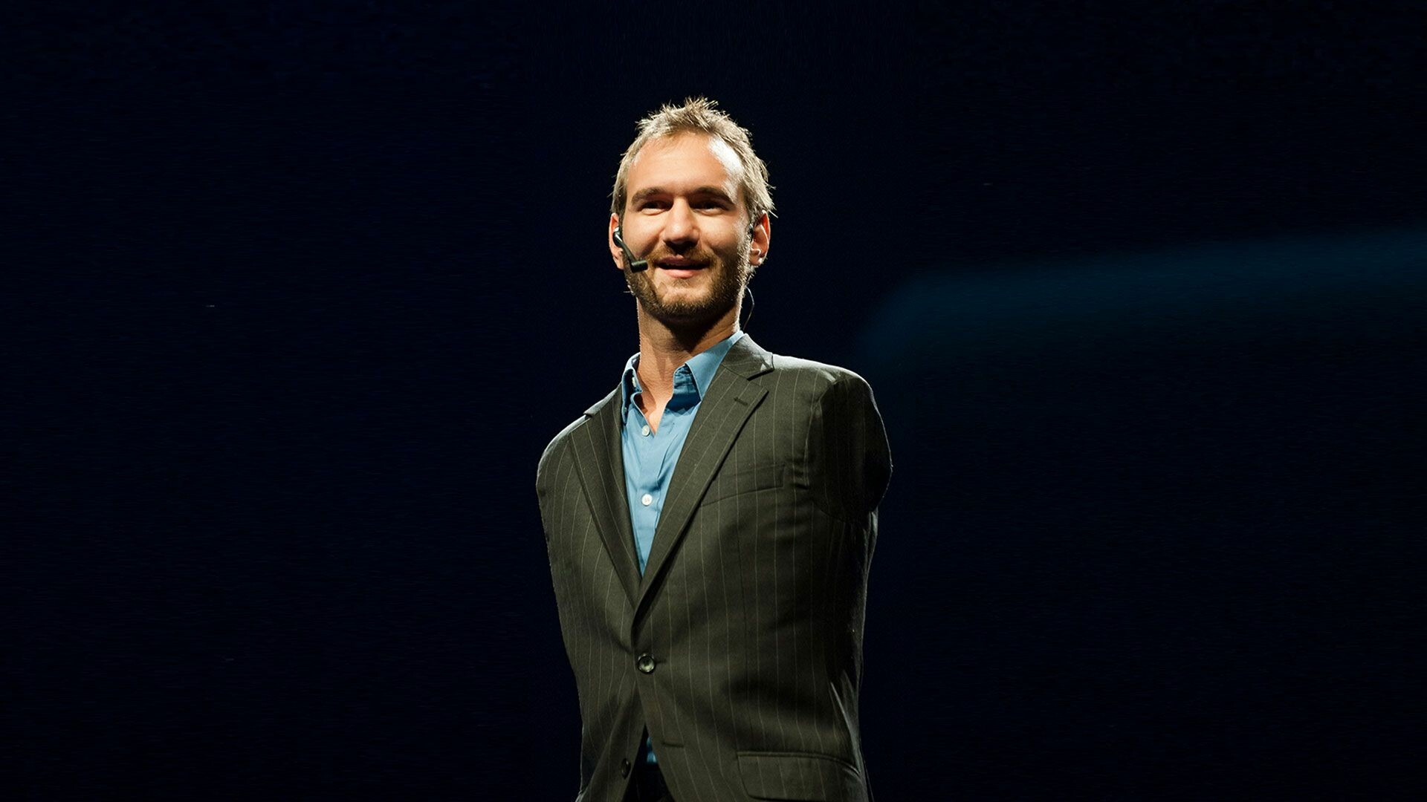
MOTIVATIONAL
SPEAKER
Widely recognized for his powerful and inspirational speaking engagements.
Ability to share his personal story creates a profound and relatable connection with his audience.
By openly discussing his own challenges and triumphs, he breaks
down barriers and fosters empathy.
Life story serves as living proof that one can triumph over
difficulties with determination and a positive mindset.

Slide 8






AUTHOR
an accomplished author
written several books,
  Life Without Limits: Inspiration for a Ridiculously Good Life
  Unstoppable: The Incredible Power of Faith in Action.
His writings reflect his positive and empowering philosophy.
covers a range of topics, including personal development,
faith and the pursuit of a meaningful life.

Slide 9
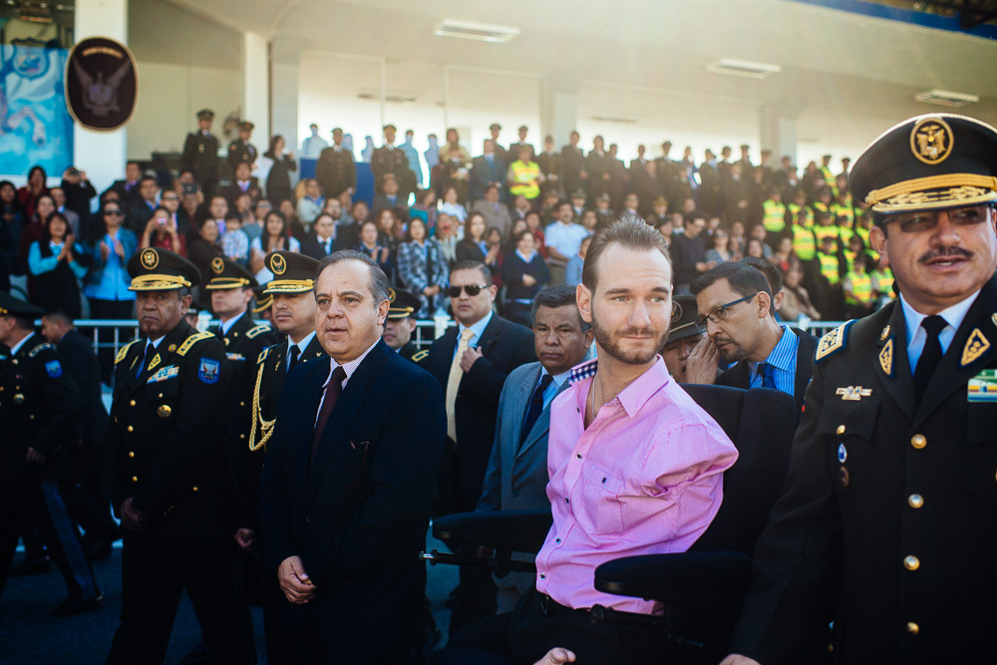
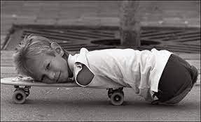
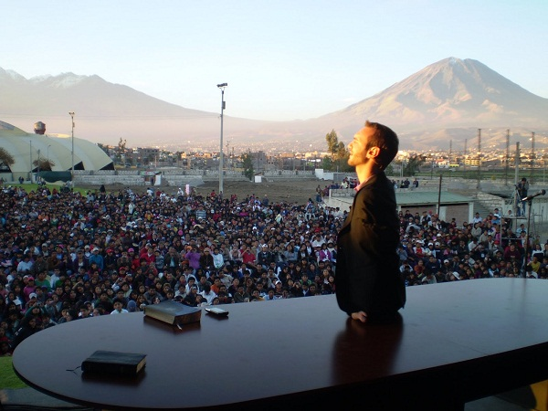
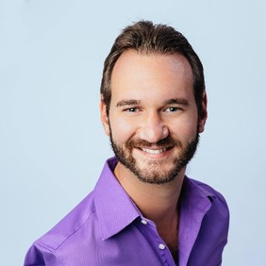
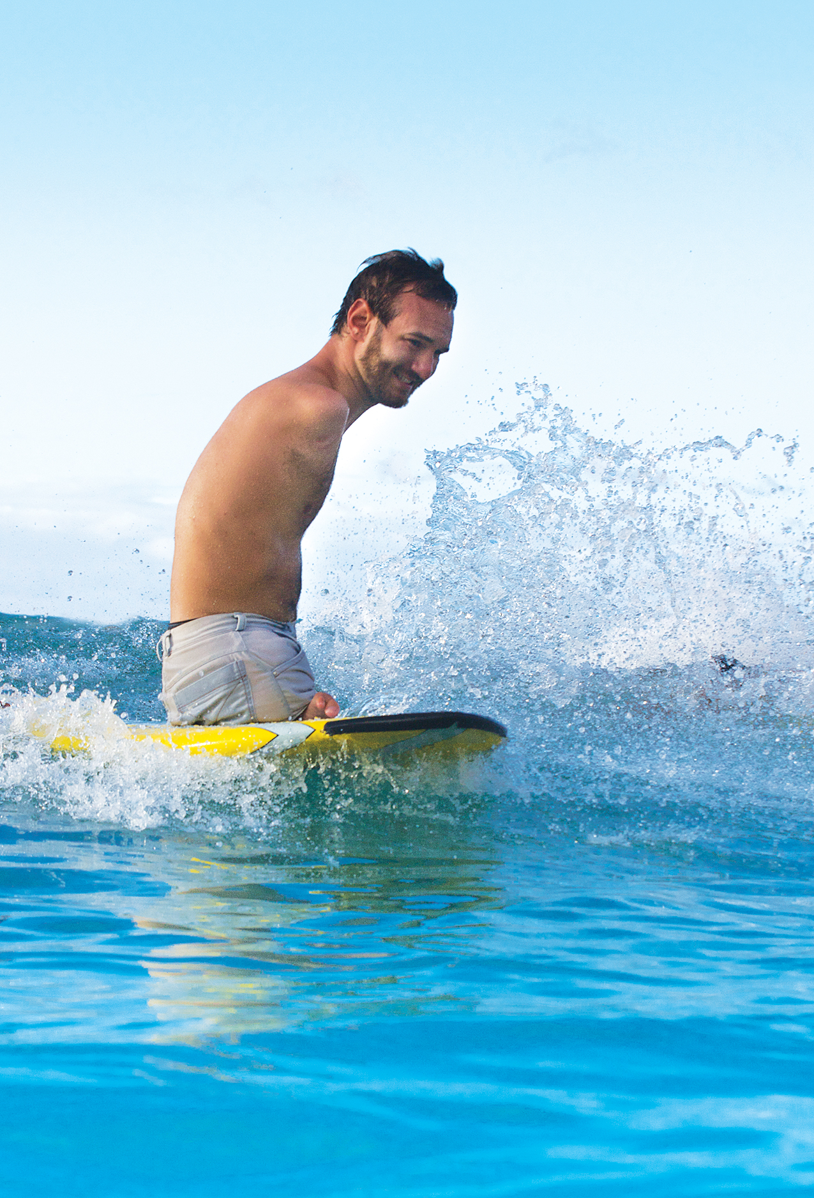
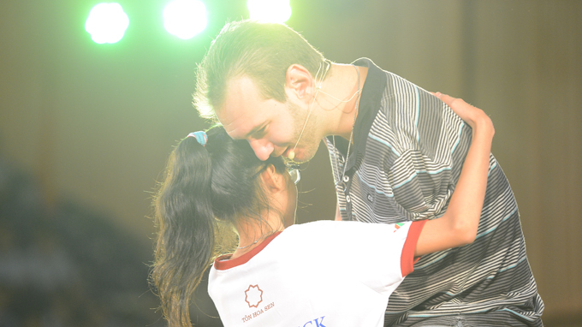
CONCLUSION
a beacon of inspiration to lead a life that defies limitations
roles as a motivational speaker, author, evangelist, educator
Happily married and welcomed four children into their family
has traveled to 78 countries, presenting on 3500 stages, to crowds as large as 800,000 people.
founding of the non-profit organization "Life Without Limbs,
which spreads messages of hope and supports individuals facing challenges.
Meeting 25 Presidents, Prime Ministers, and Vice Presidents

Slide 10
REFERENCES
(2021) Nick Vujicic. Available at: https://nickvujicic.com/ (Accessed: 13 November 2023).
(No date). YouTube. Available at: https://www.youtube.com/@nickvujicic/featured (Accessed: 14 November 2023).
IMDb (no date) Nick Vujicic - Biography, IMDb. Available at: https://www.imdb.com/name/nm3607348/bio (Accessed: 14 November 2023).
Nick Biography (2021) Life Without Limbs. Available at: https://lifewithoutlimbs.org/about/nick-biography/ (Accessed: 12 November 2023).
Nick Vujicic - attitude is Altitude.com and life without Limbs.org (no date) salvationarmy.org.au. Available at: https://www.salvationarmy.org.au/beenleigh/videos/nick-vujicic/?play=11e0y
(Accessed: 17 November 2023).

Slide 11


Slide 12

THANK YOU !

Slide 13
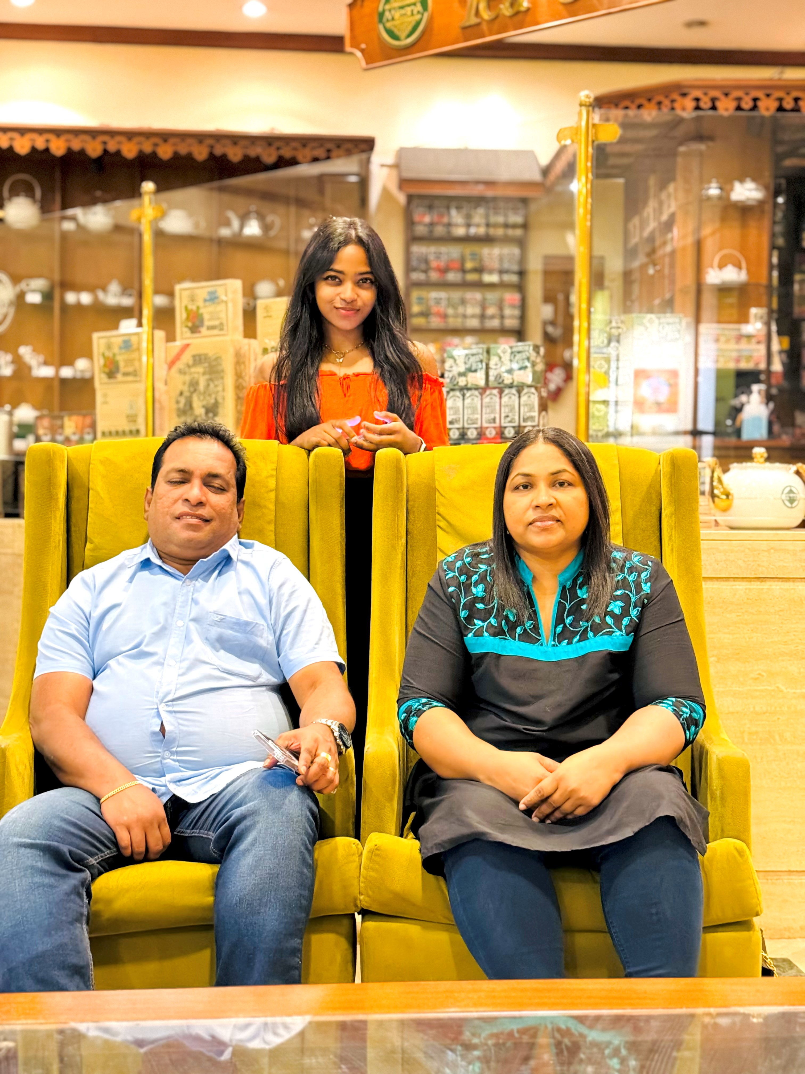
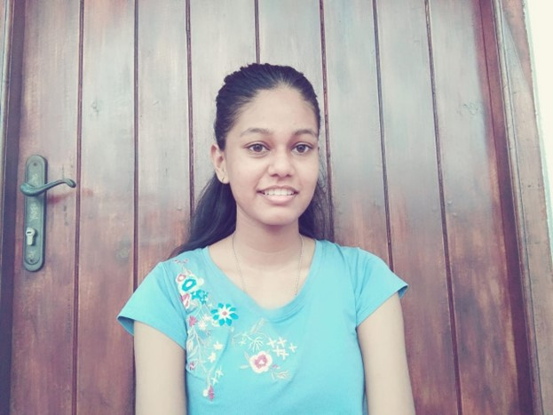
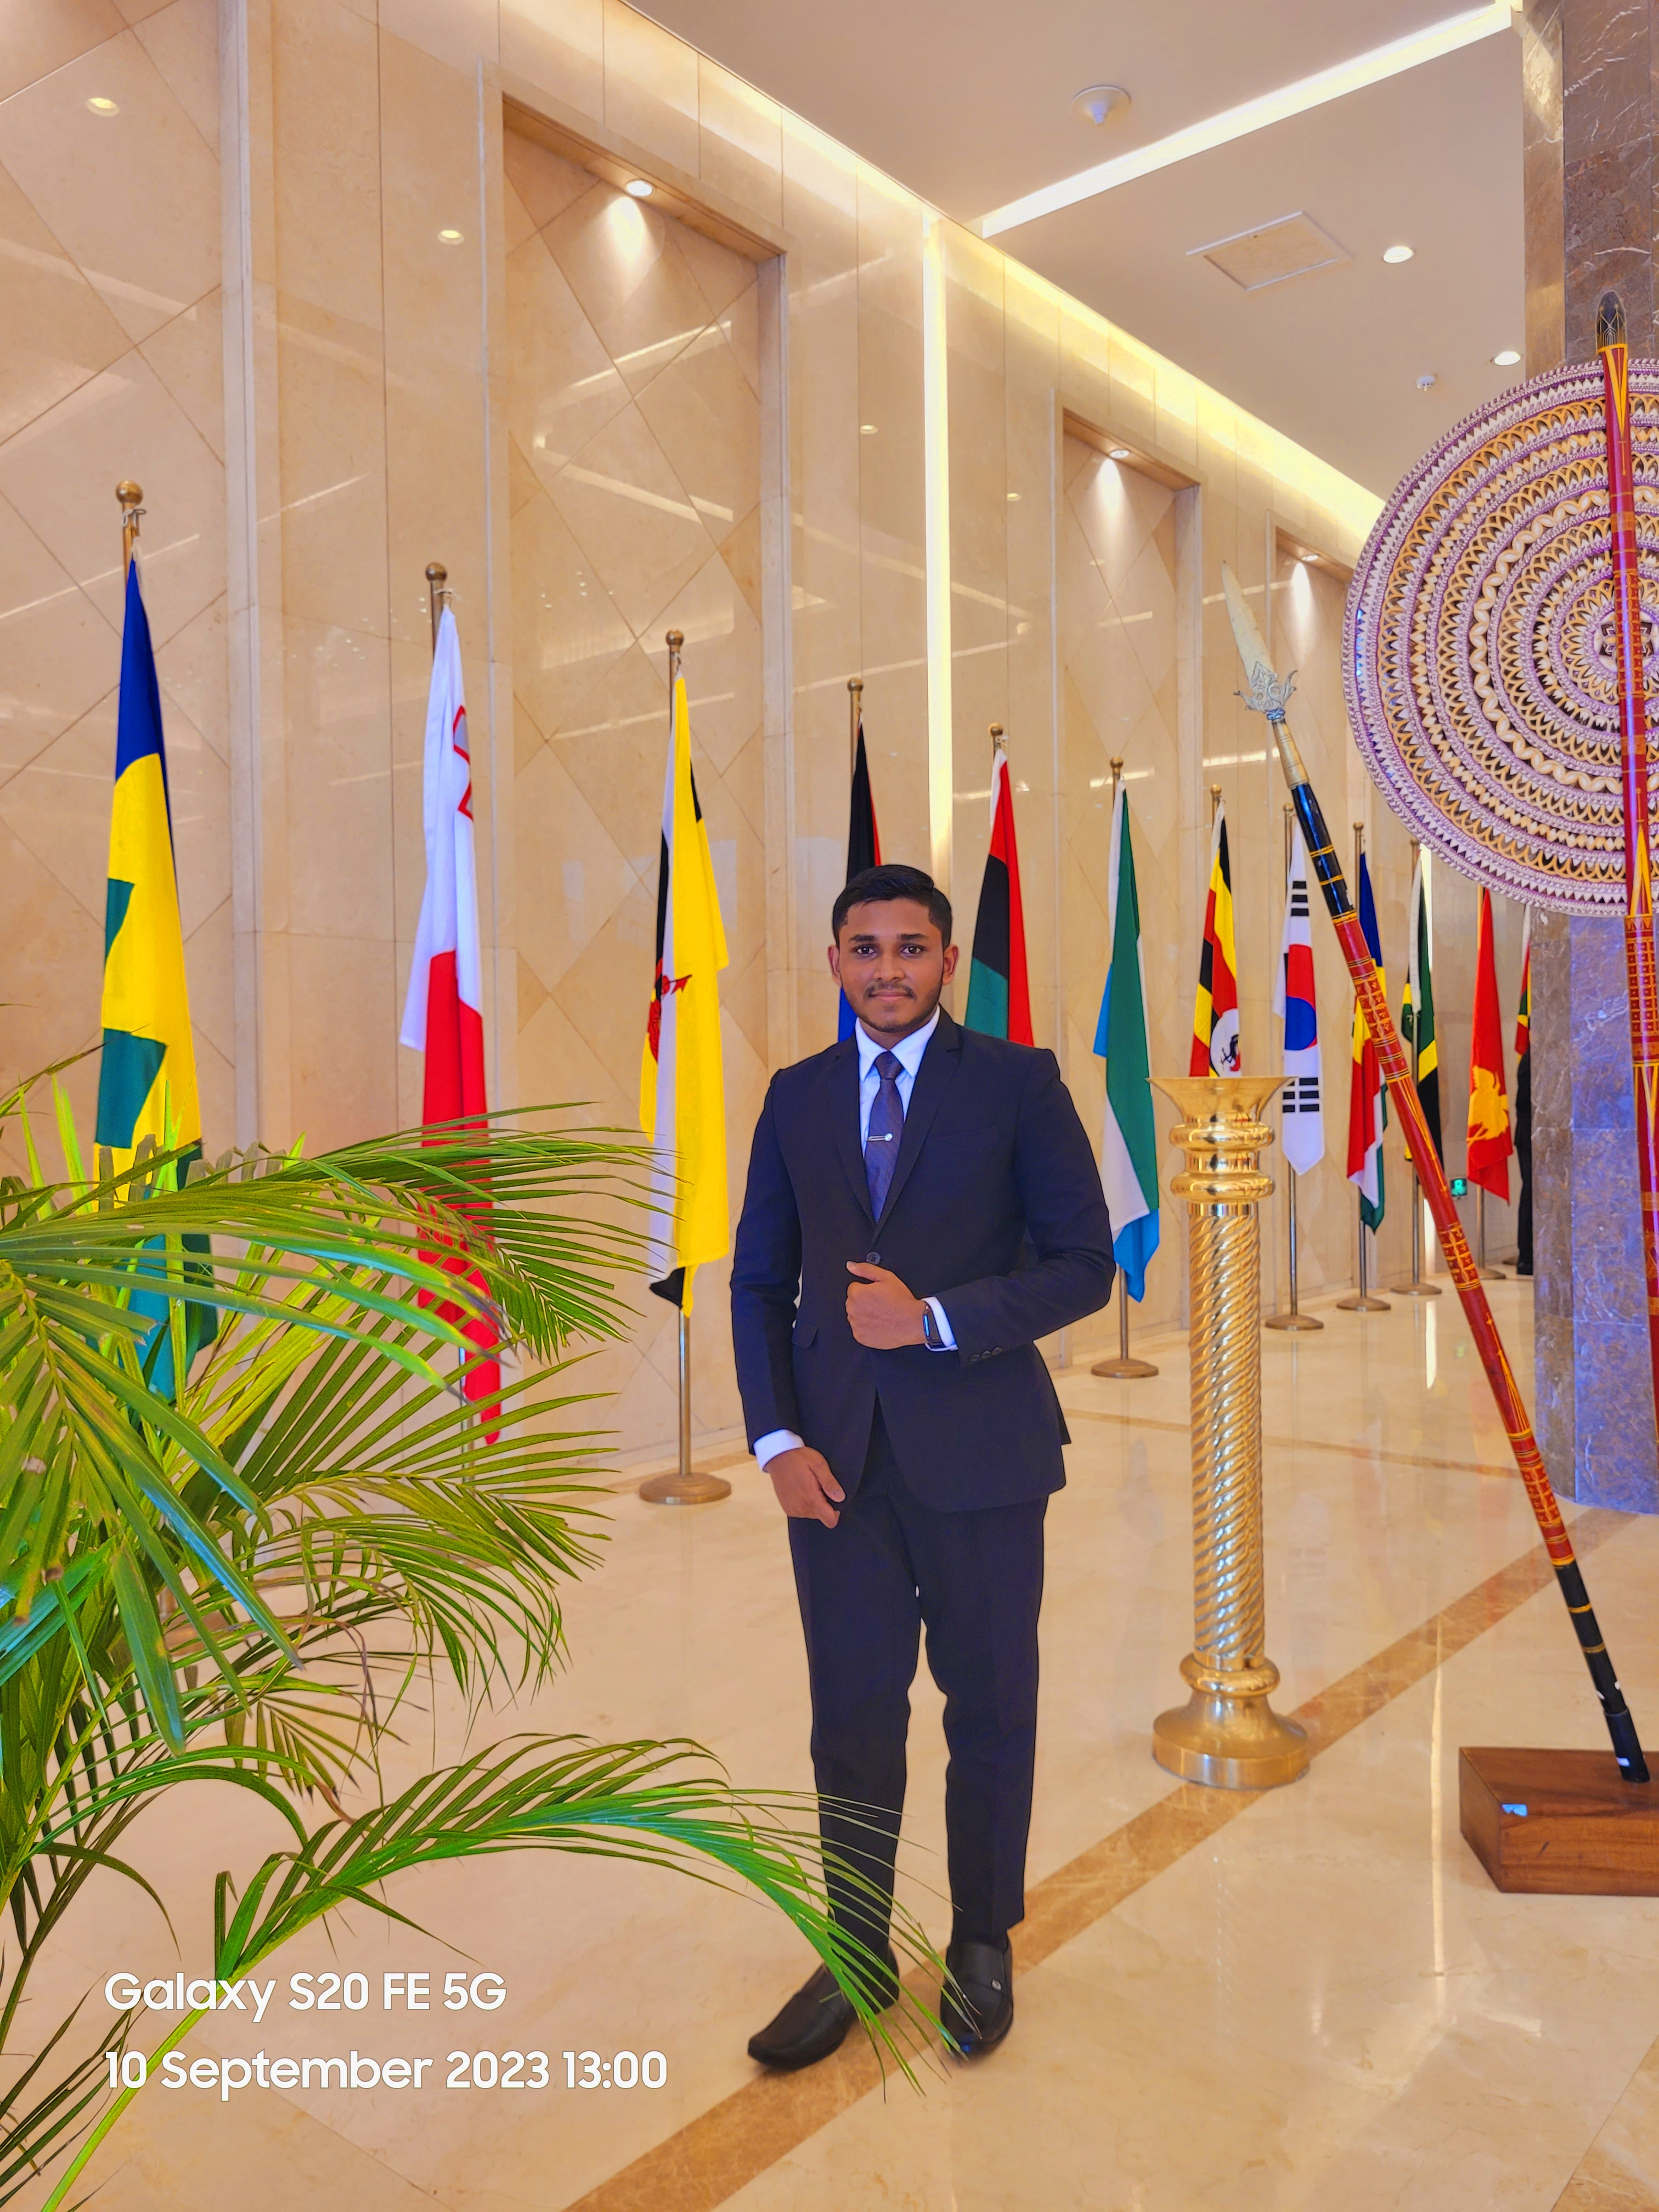
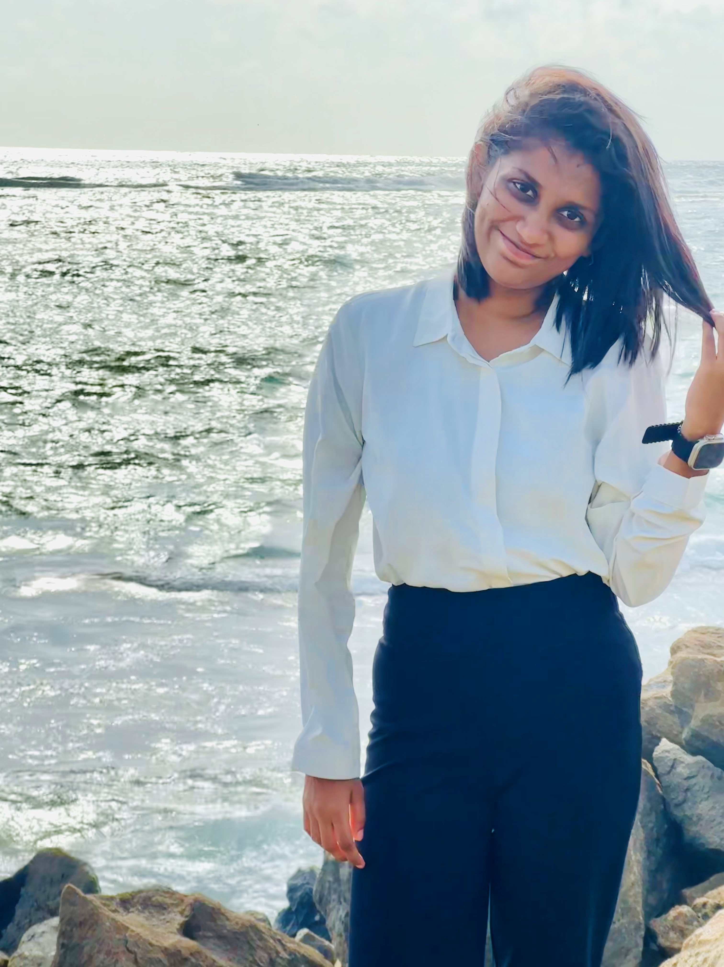
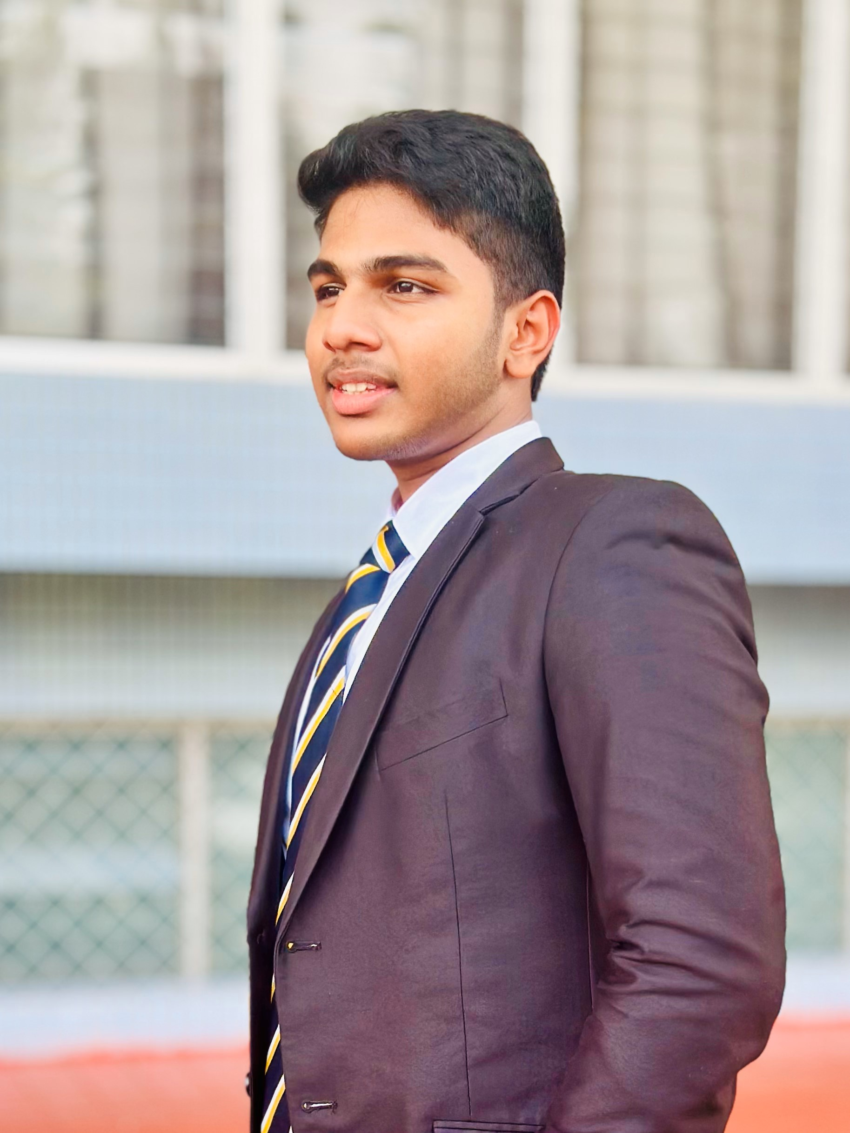

EMPOWERED
SOULS
Sanduni
Sathmi
Kaveesha
Malmi
Suvin
SANDUNI PIERIS - 20222038
Researching and gathering information
Contributing and making slides 1 , 2
Editing the presentation
Proof reading

Slide 14
EMPOWERED
SOULS
Sanduni
Sathmi
Kaveesha
Malmi
Suvin
SATHMI KODITHUWAKKU- 20222429
Researching and gathering information
Contributing and making slides 9 , 10
Proof reading

Slide 15
EMPOWERED
SOULS
Sanduni
Sathmi
Kaveesha
Malmi
Suvin
KAVEESHA RATHNAYAKE- 20222148
Researching and gathering information
Contributing and making slides 7 , 8
Proof reading

Slide 16
EMPOWERED
SOULS
Sanduni
Sathmi
Kaveesha
Malmi
Suvin
MALMI PERERA - 20222148
Researching and gathering information
Contributing and making slides 5 , 6
Proof reading

Slide 17
EMPOWERED
SOULS
Sanduni
Sathmi
Kaveesha
Malmi
Suvin
SUVIN KULASINGHE - 20221910
Researching and gathering information
Contributing and making slides 3 , 4
Proof reading

